Slide 1

Vivado Introduction
10/12/2026

Slide 2
Agenda
Objectives
1. What is Vivado
2. Common Workflow
3. Common Mistakes
4. Questions

Slide 3

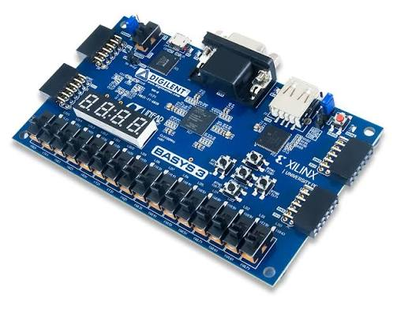
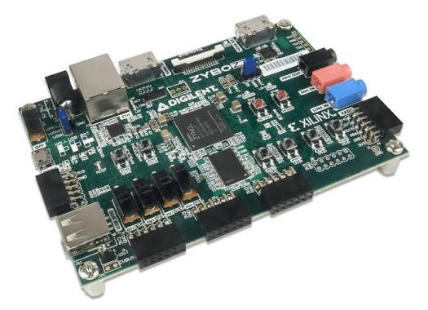
Binary representation
What is Vivado?
AMD/Xilinx’s FPGA design software
Design, simulate, synthesize, implement digital designs
Used primarily with AMD/XIlinx FPGAs
Industry standard

Slide 4
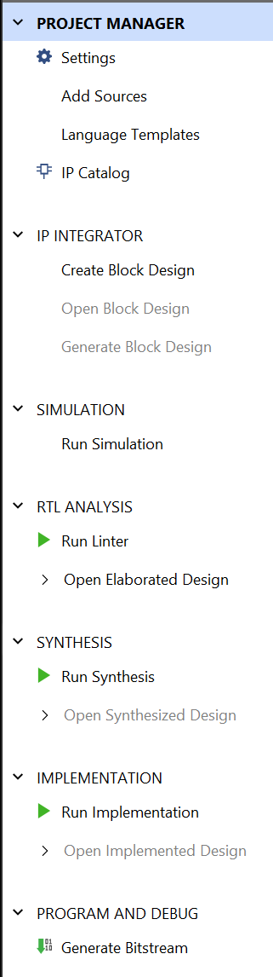
Hexadecimal representation
Common Workflow
Create project (starting block for all designs, includes selecting FPGA part)
Add sources/create sources
Implement designs
Run simulations (verify design works logically)
Run synthesis (Convert HDL to netlist)
Run Implementation (Place and route design onto FPGA resources)
Generate Bitstream (create .bit file to program FPGA)
Program Device (upload bitstream using Hardware Manager)

Slide 5
Hexadecimal representation
Common Workflow Cont.

Slide 6
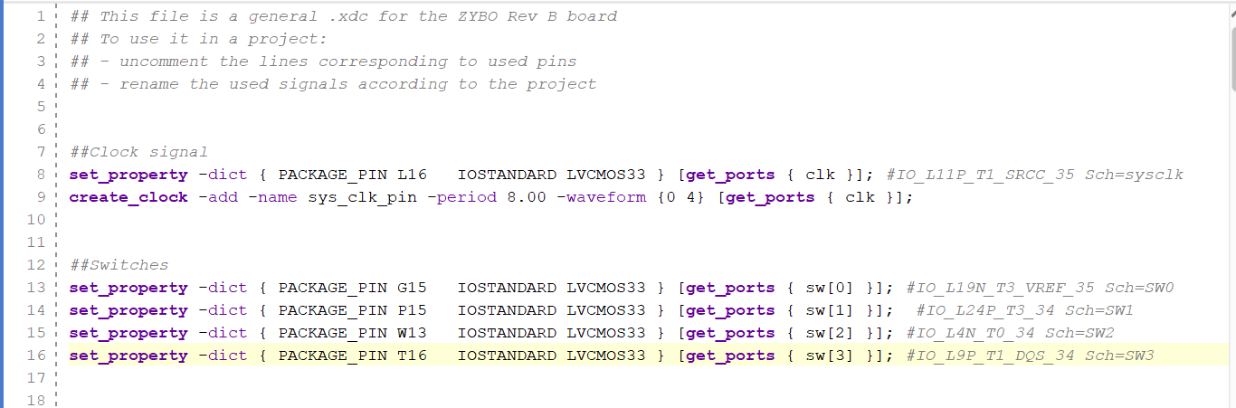
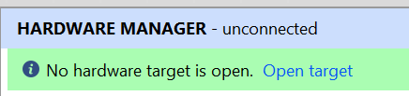
Truth tables
Common Mistakes
Selecting the wrong board/part
Forgetting to set correct top module
Missing or incorrect pin constraints
Forgetting to resynthesize, reimplement, and regenerate the bitstream
Forgetting to turn board on
Using wrong clock (mostly need board clock)

Slide 7
Questions?

